Slide 1
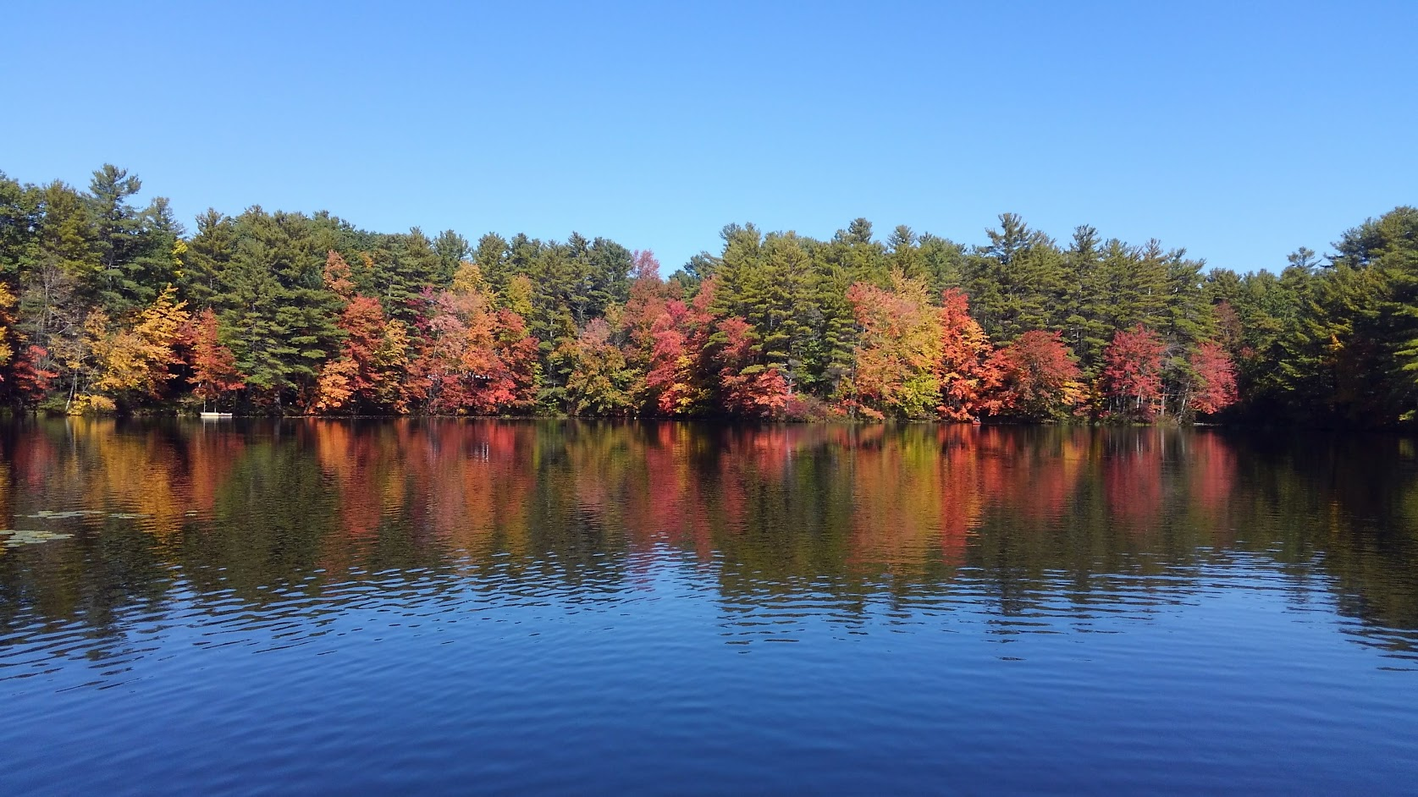
2024 Wachusett Shores and PPOA Annual Meeting
Sunday May 5, 2024

Slide 2
Agenda
Welcome
Minutes of 2023 PPOA Annual Meeting
Treasurer’s Report
Thanks to all who help keep the Association running
Old Business
New Business
Vote and set the 2025-2026 Annual Membership and Deed Assessment Fee
Elections
Q&A
Adjournment

Slide 3
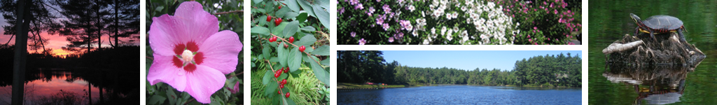
Minutes of May 2023 Annual Meeting
Annual Meeting Minutes

Slide 4
Minutes from PPOA annual meeting 5/21/2023
Annual meeting started 2:00pm with 23 owners in attendance
Thank you volunteers, we always need more volunteers
Review of minutes from last year’s annual meeting
Motion made to accept minutes, by Jeanne Carter and seconded James Garrity. Passed unanimously
Treasurer’s report presented by homeowner and presentation creator Betty Ann Sharp who walked everyone through the numbers for fiscal year ending on March 31, 2023 and the budget for this coming year. See presentation. Reminder, some money was taken out to pay for the multi-year pond restoration. The 2020 annual meeting voted to spend 30k and we came in $700 under budget. Dues paid does not reflect people who paid at the annual meeting. 15 people paid at the meeting today. Motion to accept was made by Jim Ellis and seconded by Marylou Ingemie and approved unanimously

Slide 5
Minutes from PPOA annual meeting 5/21/2023
Leaking well at lodge has been repaired. Thank you volunteers for taking on this task and saving the association lots of money
Jim Ellis gave a presentation about the completion of the pond treatment. We really appreciate all the help of volunteers and volunteer equipment to help move material from PPOA property.
Jay Goguen and Jim Ellis will do the beach testing this year.
Friendship fireplace immediately following annual meeting.

Slide 6
Minutes from PPOA annual meeting 5/21/2023
New swing set is in place and looks great. Put in by a professional installer. The neighborhood kids love it. Cost has been fully covered.
Board voted to stop trash service at lodge. Please bring your trash home. We will still have trash service at the beach.
Annual BBQ will be August 19th . Bill will bring his trailer and cook. We all agree Bill’s chicken is fabulous. Hopefully we can get people playing volleyball.
Multimedia for lodge. Board is looking into it.

Slide 7
Minutes from PPOA annual meeting 5/21/2023
If you have a boat at the beach, you must lock it and don’t leave paddles or oars. It could be a hazard if someone uses a boat that is not theirs and don’t have life jackets. PPOA board has locked all unlocked boats with a note saying they need to lock their boat and contact the board to get it unlocked. Maybe auction off unclaimed boats at the beach party.
Budget for 2023-2024 presented. • Bill P. made a motion to keep annual deed assessment and maintenance fee at $200 seconded by Lee Carter and approved unanimously.
Board is working on improving communication
Justin Sylvia and Tim Humphrey nominated by Bill Homans. and seconded by Lee Carter. Elected unanimously to the board.
Motion made to renominate Dave Blad, Dennis Majikas, Bill Homans, Bill Poudrier. by Jim Ellis seconded by Lee Carter. Elected unanimously.
Jody Holden is willing to be an associate
Motion to adjourn unanimously at 3:03pm Minutes prepared by Jim Ellis

Slide 8
Treasurer’s Report

Slide 9
TOTAL NET WORTH as of 3/31/2024
Investment portfolio | $278,671.91
Cash | $22,208.93
Total assets | $300,880.84
Total liability | $0.00
Net worth | $300,880.84

Slide 10
Payments History (FY'2018 - FY’2024)
Payment as of date of Annual Meeting.

Slide 11
Investment Portfolio

Slide 12
Edward Jones Asset Allocation
Total Portfolio as of March 31, 2024

Slide 13
FY 2024 Expenses
EXPENSES | BUDGET | ACTUAL | VARIANCE
Town Real Estate Taxes | $1,700.00 | $1,621.67 | $78.33
Porta Potti for beach | $800.00 | $699.58 | $100.42
Charter Communications – Internet, phone | $3,450.00 | $3,297.33 | $152.67
National Grid (Electric) | $1,300.00 | $910.02 | $389.98
Trash (E.L. Harvey and Sons & Republic) | $500.00 | $183.79 | $316.21
Security Alarm Systems | $260.00 | $299.40 | $(39.40)
USPS (Stamps) | $200.00 |  | $200.00
Broberg Insurance (Liability & Lodge) | $6,625.75 | $6,625.75 | $ -
Huhtula Oil (Fuel) | $2,000.00 | $1,841.54 | $ 158.46
PO Box Annual Renewal | $70.00 | $78.00 | $(8.00)
E.coli Test & Variance Survey | $350.00 | $280.00 | $70.00
Web Site Hosting Renewal | $175.00 |  | $175.00
2023 Tax Filings MA | $71.00 | $227.79 | $(156.79)
Tax Accountant | $800.00 | $825.00 | $(25.00)
Mailings/Meetings/Supplies | $500.00 | $444.64 | $ 55.36
Spring Cleanup/Annual Beach Party | $500.00 | $616.00 | $(116.00)
Other: Flowers, Fruit, T-Shirt print |  | $424.98 | $(424.98)
TOTAL OPERATING EXPENSES | $19,301.75 | $18,375.49 | $926.26

Slide 14
FY 2024 MAINTENANCE & IMPROVEMENTS
 | PLAN | ACTUAL YTD | VARIANCE
Lodge cleaning & supplies | $200.00 | $0.00 | $200.00
General Repairs & Maintenance | $3,000.00 | $390.45 | $2,609.56
New Swing Set for Beach | $5,350.00 | $5,463.56 | ($-113.56)
Fuel / Supplies for Mowing, etc. | $100.00 | $134.60 | (-$34.60)
TOT. MAINTENANCE & IMPROVEMENTS | $8,650.00 | $5,988.61 | $2,661.39

Slide 15
FY 2024 INCOME
INCOME | PLAN | ACTUAL YTD | VARIANCE
FY 2024 Maint. Fees (Plan: 185 x $200) | $37,000.00 | $21,111.00 | ($15,889.00)
Past Due Maint Fees / Interest | $63,000.00 | $3,318.43 | ($59,681.57)
Lodge Rentals | $500.00 | $900.00 | $400.00
Interest (GFA Checking) | $7.00 | $2.32 | ($4.68)
Interest (GFA Savings) | $2.00 | $3.48 | $1.48
Dock Fees | $150.00 | $200.00 | $50.00
Other – T-shirt and United service Reimbursement / Refund |  | 477.26 | $477.26
TOTAL INCOME | $100,659.00 | $26,012.49 | ($74,646.51)

Slide 16
Operating Budget

Slide 17
Thanks Volunteers!
Thank you to all of our neighbors who have volunteered to help PPOA throughout the year. It’s your neighborhood, and you help keep it running!

Slide 18
What PPOA Volunteers Accomplished
New Swing set
Two clean-ups plus a lot of work on trails restoration outside of the cleanup
Boats on the beach are monitored to make sure they are locked.
Beach water testing
Friendship Fireplaces
Announcements posted to ppoa.info and Facebook
Painted lodge and sheds
Map of trails with GPS accessed by QR code
Both dams checked and cleaned weekly
Sent out annual letter and billing
Sledding hill cleared
Grass mowed
Goose abatement
Lodge rental coordination
Welcome kits to new neighbors
Festive and informative signs on the street
Flower arrangements for the lodge window boxes
Monthly meetings in person and zoom
New picnic bench at beach
Pond maintenance efforts
And so much more!

Slide 19
Old Business
  Replace Swing Set
  Trail maintenance
  Lodge rental coordinator

Slide 20
New Business
  Set date for Annual Beach Party
Google account
Abandoned boats
Cost of Charter
Dam Maintenance
New Lodge TV
Beach Veranda
Pond Treatment

Slide 21
Pond Treatment
  Lilies came back quicker than we would like. Especially in bay away from the dam.
  Recommendation to treat the pond again, and to start the treatment early, stronger concentration.
  Prepping the pond by lowering the level.
  Ready to begin treatment on 5/10/24.
  Cost has been budgeted but needs to be voted on at this meeting.

Slide 22
FY 2025 Budget Proposal

Slide 23
PROPOSED 2025 BUDGET
EXPENSES | BUDGET |  | INCOME | BUDGET
Town Real Estate Taxes | $1,700.00 |  | Maint Fees (Plan: 183 x $200) | $36,600.00
Porta Potti @ Beach | $717.00 |  | Past Due Maint Fees Est | $3,000
Charter Communications | $3,600.00 |  | Lodge Rentals | $750
National Grid (Electric) | $1,300.00 |  | Interest (GFA Checking) | $2.50
Trash | $300.00 |  | Interest (GFA Savings) | $2.50
Security Alarm Systems | $325.00 |  | Dock Fees | $150
Broberg Insurance (Liability & Lodge) | $6,933.00 |  | TOTAL INCOME | $40,505.00
Huhtula Oil (Fuel) | $2,250.00
PO Box Annual Renewal | $80.00
E.coli Test (Nashoba Analytical) | $300.00 |  | Total Expenses | $40,355.00
Web Site Hosting Renewal | $200.00 |  | Total Income | $40,505.00
2023 Tax Filings | $300.00 |  | Net Cash Flow: | $150.00
Tax Accountant | $850.00
Mailings/Meeting Supplies | $750.00
Spring Cleanup/Annual Beach Party | $750.00
TOTAL OPERATING EXPENSES | $20,355.00
MAINTENANCE & IMPROVEMENTS | BUDGET
Lodge cleaning & supplies | $1,250.00
General Repairs & Maintenance | $6,500.00
Fuel / Supplies for Mowing, etc. | $250.00
Pond Maintenance | $12,000.00
TOTAL MAINTENANCE & IMPROVEMENTS | $20,000.00
TOTAL EXPENSES | $40,355.00

Slide 24
Voting
Pond Treatment
2024-2025 Annual Maintenance and Deed Assessment Fee
PPOA Board of Directors

Slide 25
Pond Maintenance Vote
Two vendors were contacted. Solitude (previous vendor) and Water and Wetland. Solitude did not provide a timely quote. Water and Wetland promptly provided the following:
Goal: 10 ppb range to control the bladderwort and milfoil, closer to 20 ppb in the water to get strong control of the lilies.
Based on dissipation #’s from 2022 and the fact that Sonar will break down faster in 2.5 ft of water vs our typical 4-6 ft treatment areas, the following program is recommended to keep about 20 ppb in the water for the first half of the summer.
Maintain approximately 20 ppb Sonar Genesis in the pond for 60+ days. Start early in the spring before lilies reach the surface.

Slide 26
● Application #1 – 30 ppb in Early May.
● Application #2 – 30 ppb in approximately mid-June.
Cost includes the treatments (labor and product), DEP permit, pre-survey, post-survey, year-end report.
One round of FasTests in 2 locations.
Price: $11,990.
There is no restriction on swimming except for the day of application.

Slide 27
2025-2026 Annual Maintenance and Deed Assessment Fee Vote
Current fee is just $200 per year.
Board of Directors recommendation:
Keep the fee at $200 per year.

Slide 28
PPOA Board Of Directors Vote
  PPOA Members vote for the members of the Board of Directors. The BOD elects the officers at the following monthly meeting.
  Current elected board and current positions:
  President: Bill Homans (Expires 2025)
  Treasurer: Gail Orciuch
  Clerk: Dennis Majikas (Exp. 2025) / Jim Ellis Assistant
  Directors: Josh Adams (Exp. 2024) Dave Blad (Exp. 2025) Bob Brooks (Exp. 2025) Jeanne Carter (Exp. 2024) Lee Carter (Exp. 2024) Tim Humphrey (Exp. 2025) Bill Poudrier (Exp. 2025) Justin Sylvia (Exp. 2025) Associate: Jim Ellis, Jody Holden Webmaster: Brendon Toupense
  In addition to the BOD, volunteers are always needed and much appreciated.

Slide 29
Important Upcoming Dates
Spring Cleanup May 18 9AM-Noon
Friendship Fireplace May 18 6:30 PM
Annual Beach Party August 17 2:00 PM
Fall Clean-Up Sept 7 9AM to Noon
Annual Dues Due April 1, 2025
Annual Meeting May 4, 2025
Spring Clean-Up TBD May 2025
Watch signboards, PPOA.info and Pinecrest of Hubbardston on Facebook for dates and events.

Slide 30
Q & A

Slide 31
Thank You

